Slide 1
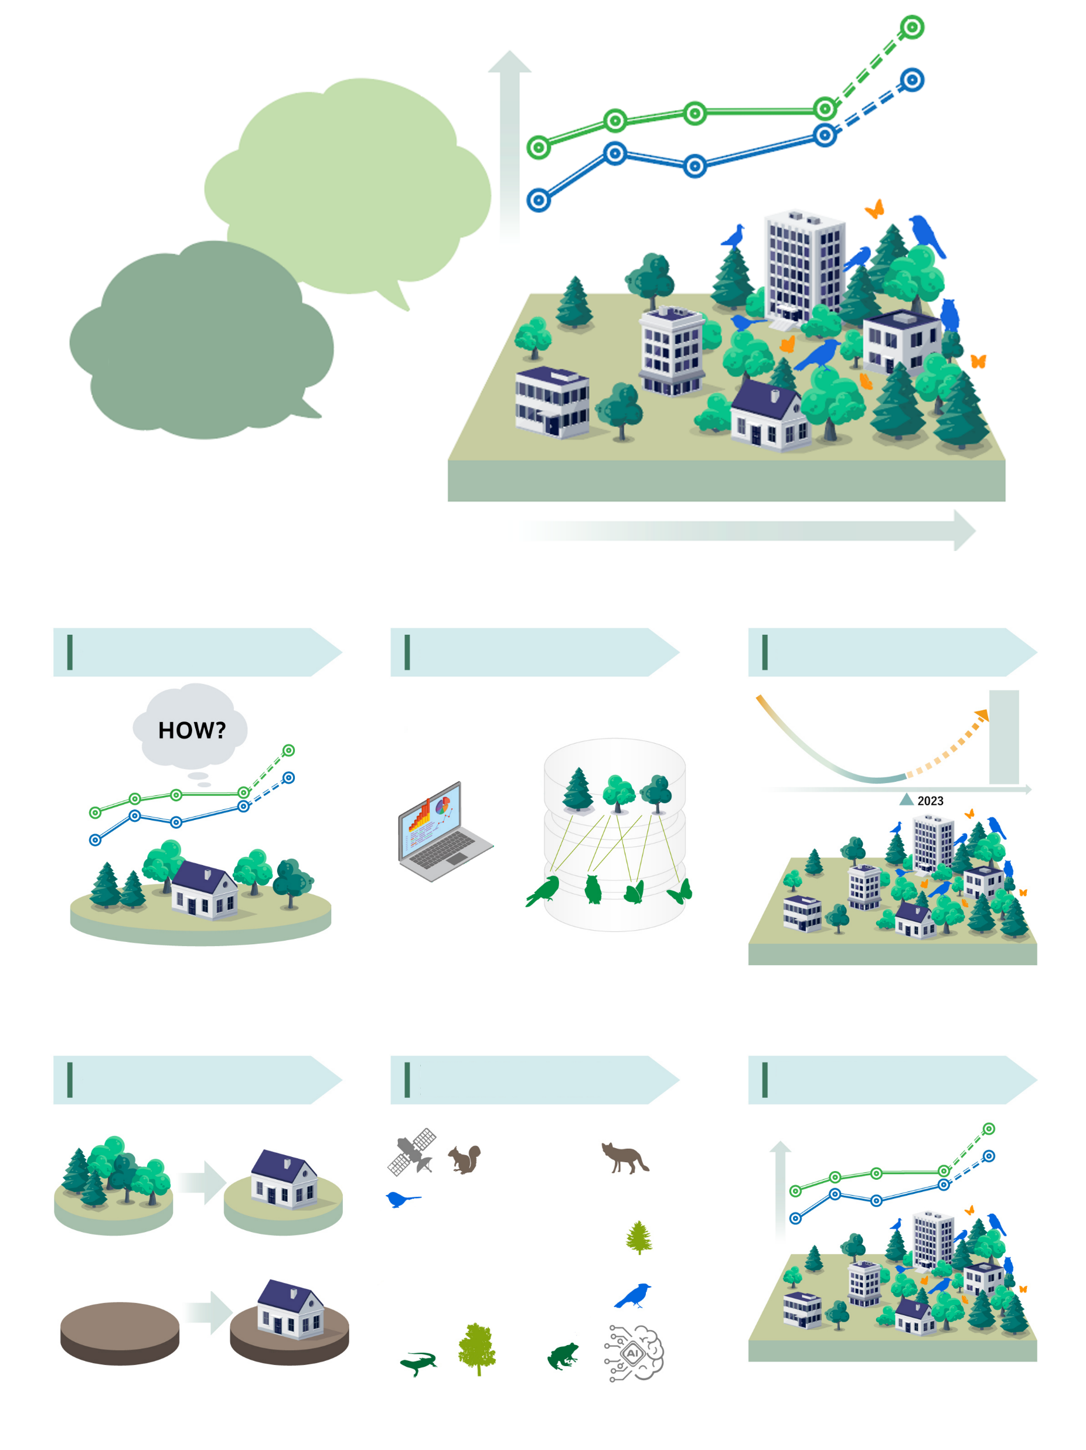
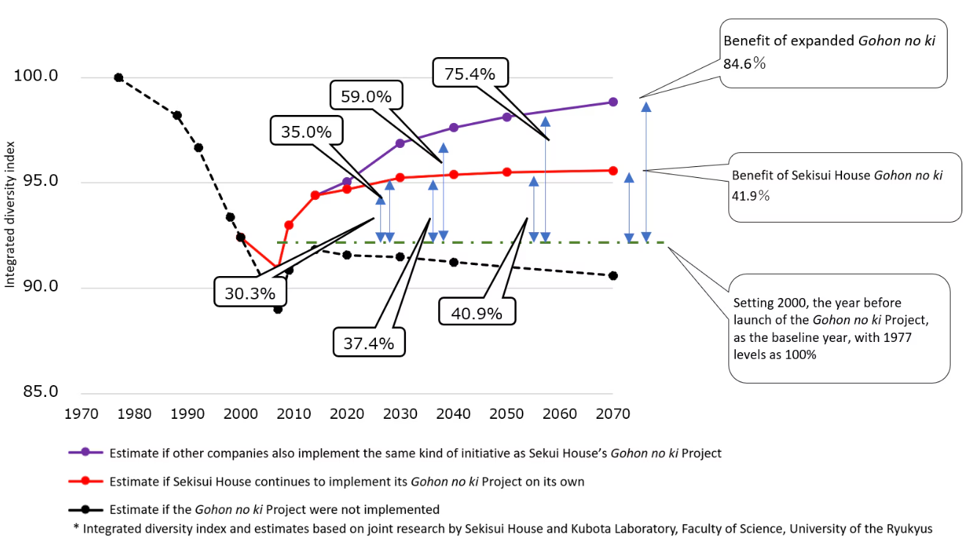

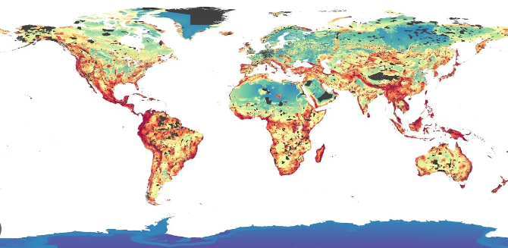
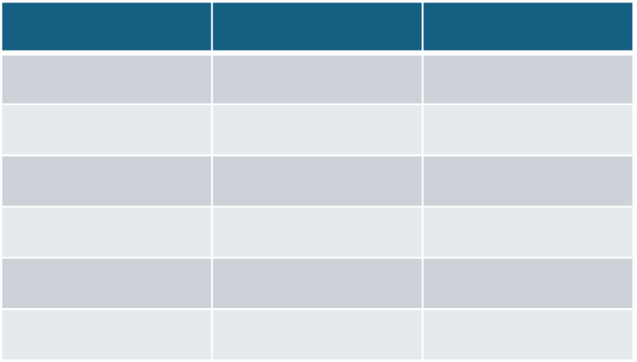
How to quantify net gains produced by green infrastructure?
How can our company conduct natural regeneration based on science?
Needs for regeneration
of nature on residential lots
Calculate restoration potential using species distribution data
Analise land use history in the focus locations
Data on animals using planted trees as habitat
Propose the best species composition for your location
Natural regeneration effects quantified

Slide 2
